Slide 1
APPLICATION TESTING
Alpha and Beta Testing!

Slide 2
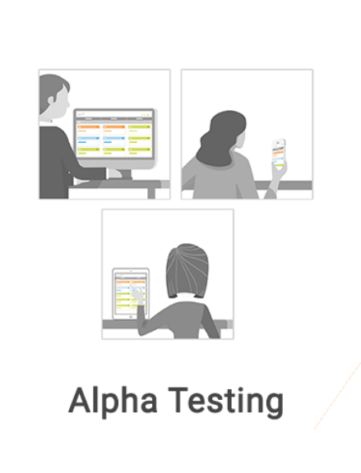
Alpha Testing
Alpha Testing is in-house testing where a testing lab is set up for developers and testers (who were not a part of the software development project team) to test the application.

Slide 3

Beta Testing
Beta Testing is an approach to get feedback from a sample of users from outside the company

Slide 4

POTENTIAL RISKS AND STRATEGIES TO PREVENT THESE RISK!

Slide 5
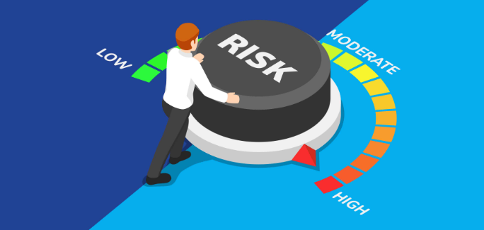
POTENTIAL RISKS

Slide 6

Strategies

Slide 7
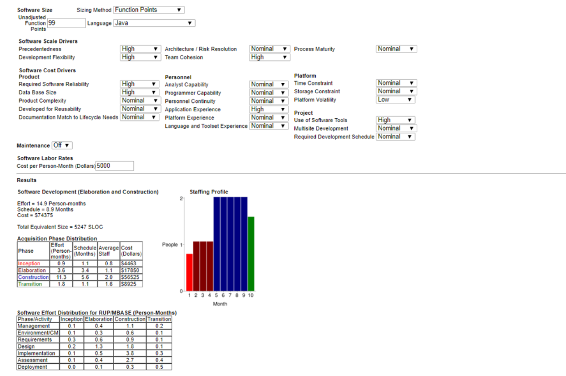
THE COST OF THE SYSTEM
Cost per person per month: $5000.00
Effort: 15 persons
Schedule: 8.9 months
Total: $74,375.00

